Slide 1
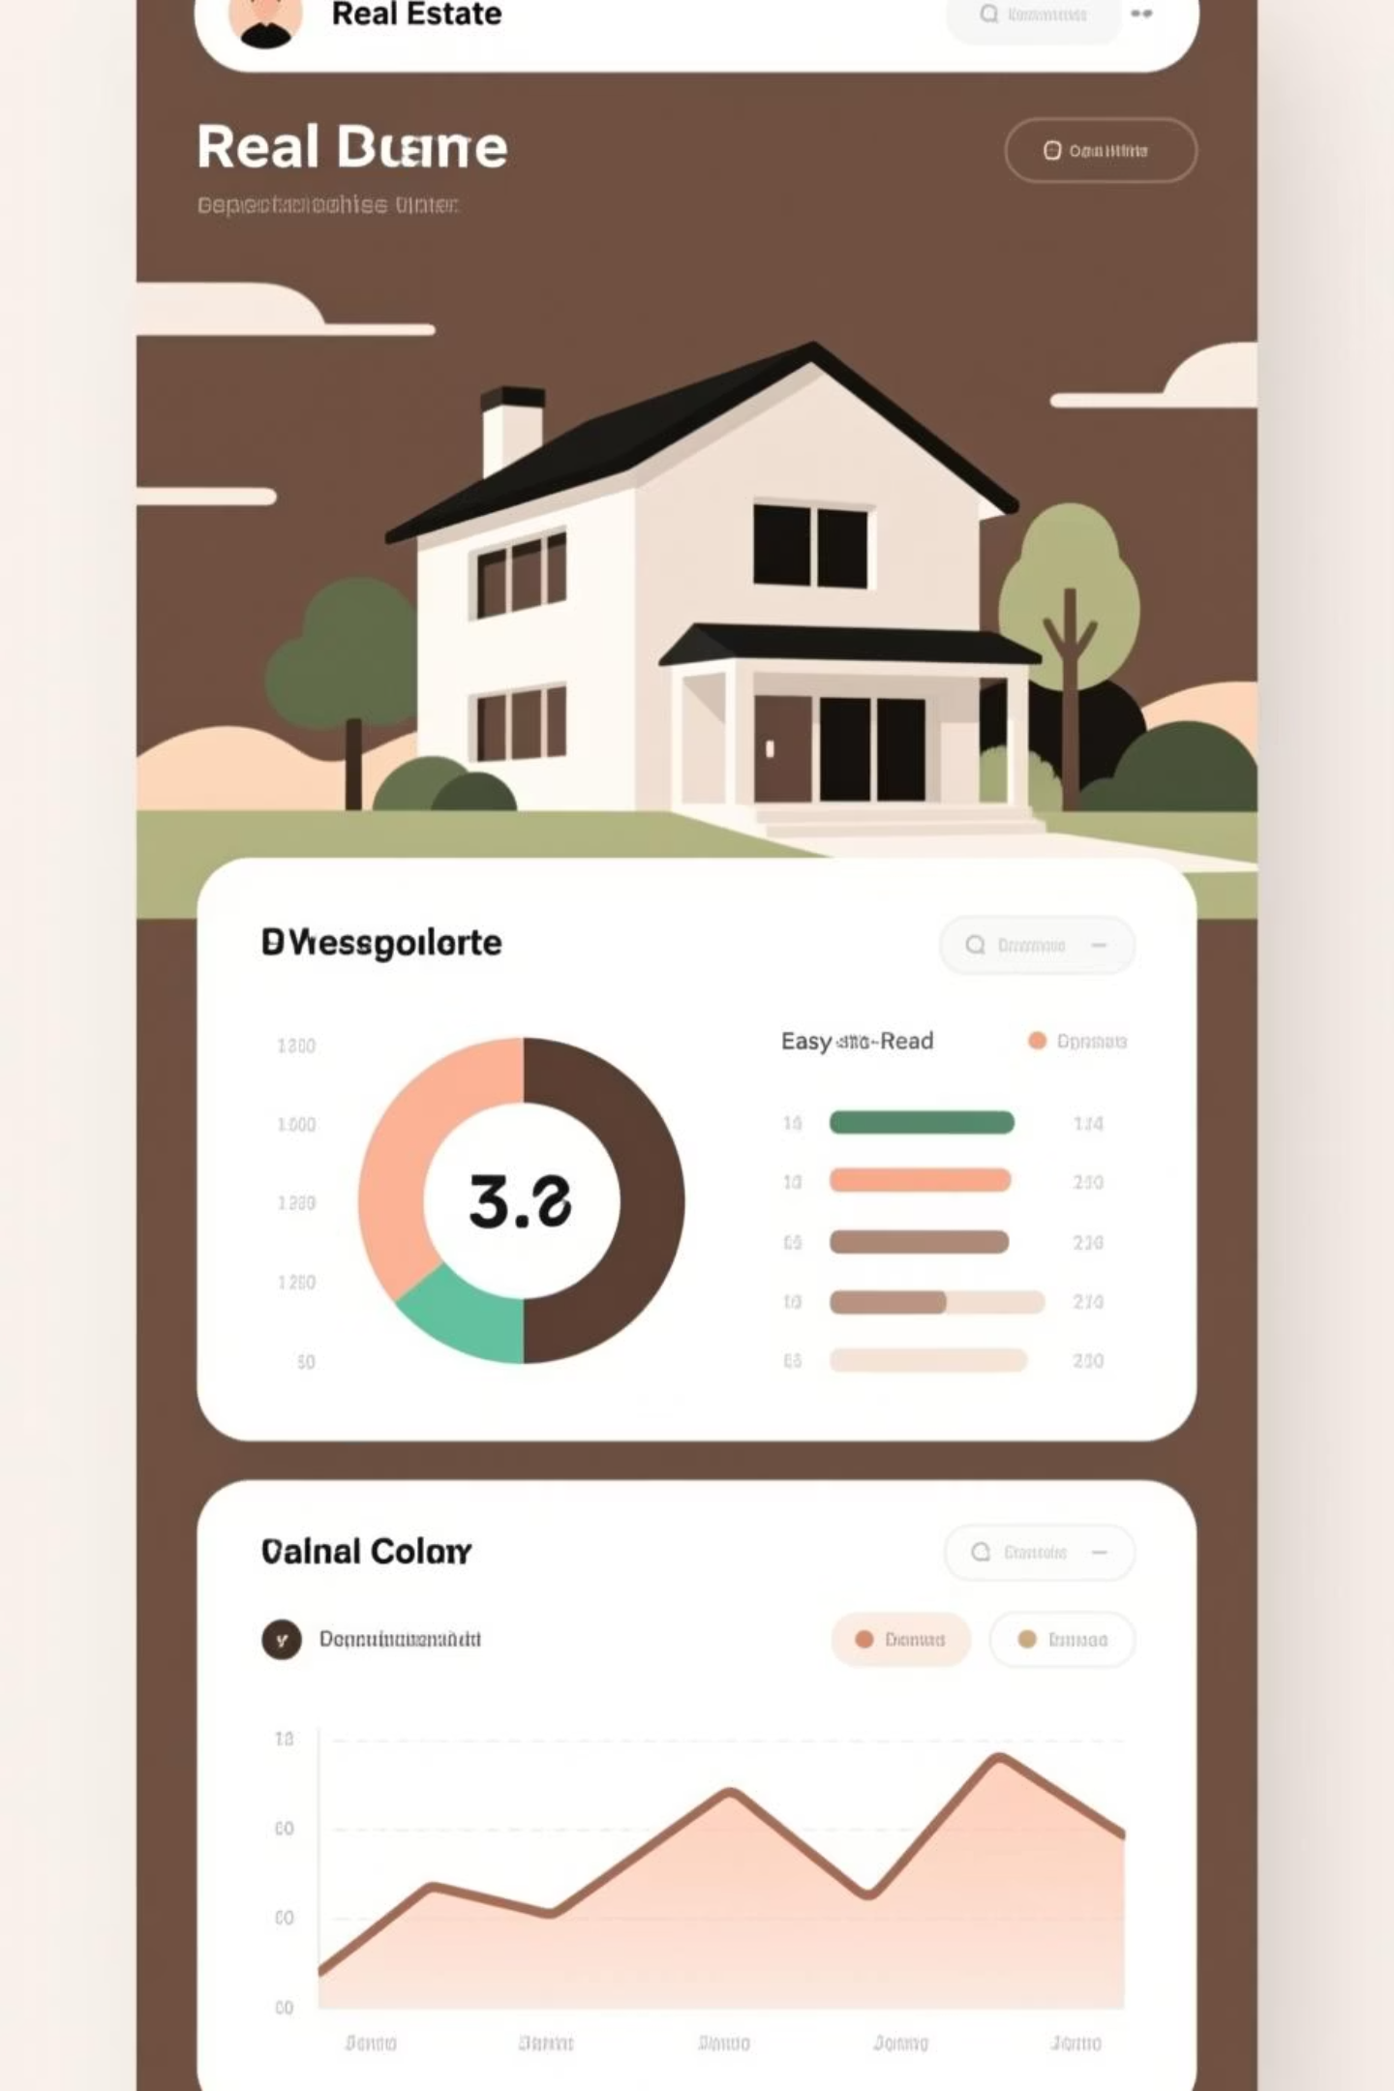
Laddr: The Full-Stack Real Estate Investment Platform
Laddr is a comprehensive full-stack web application designed to revolutionize real estate investment. It empowers users—from novices to experienced investors—to explore, analyze, compare, and manage property investments using an intuitive dashboard and advanced analytics tools.
Our platform aggregates critical property data, provides actionable market insights, and facilitates data-driven decision-making, ensuring a seamless user experience across all stages of the investment lifecycle.

Slide 2




Core Technology Stack
Laddr is built on a modern, flexible, and scalable tech stack, ensuring high performance and maintainability across both frontend and backend operations. The selection prioritizes widely adopted and robust open-source technologies.
Frontend
Backend & API
Data Storage
React.js (v19.2.0) with JavaScript for building a dynamic Single-Page Application (SPA) and component-based user interface.
Node.js with Express.js for developing scalable and modular RESTful APIs that handle business logic and data requests.
MongoDB (NoSQL) offers flexible schema design, essential for storing diverse and rapidly changing real estate property data.
This combination allows for efficient development cycles and robust performance under varying load conditions.

Slide 3
Frontend Frameworks and Libraries for Enhanced UX
The Laddr frontend leverages a powerful set of libraries to deliver a rich, interactive, and responsive user experience, focusing heavily on data visualization and geospatial data display.
Routing & Data Fetching
Visualization & Mapping
Styling & Reports
React Router DOM (v7.9.5) for fast, client-side routing.
Recharts (v3.3.0) for professional-grade charts and data graphs.
Tailwind CSS (v3.4.18) for utility-first styling and responsive design.
Axios (v1.12.2) for efficient HTTP requests to the backend APIs.
Leaflet (v1.9.4) and React-Leaflet (v5.0.0) for interactive property and market location maps.
jsPDF (v3.0.3) for generating high-quality, printable investment reports.
Using Tailwind CSS ensures a mobile-friendly and accessible user interface from the ground up, crucial for investors on the move.

Slide 4
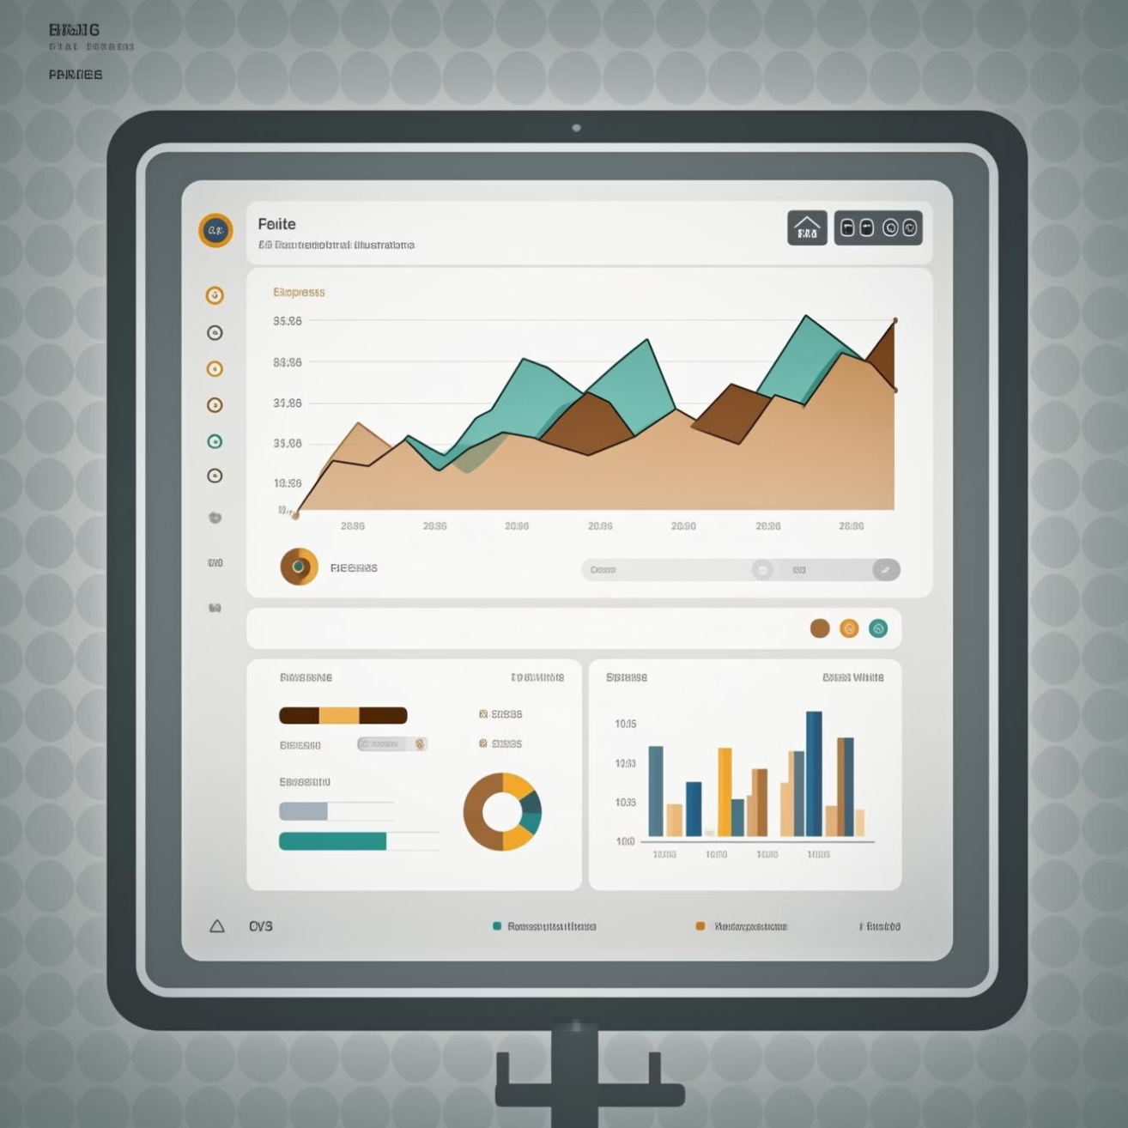
Key Feature Overview: Empowering Investor Decisions
Laddr offers a comprehensive suite of features designed to guide users through the entire investment analysis process, from discovery to portfolio management.
1
Secure Access and Personalized Dashboard
Robust User Authentication (Login/Signup) followed by a personalized Dashboard showing portfolio performance and recent activity metrics.
2
Property Discovery and Filtering
Browse properties using advanced filters covering location, price range, property type, and amenity specifics.
3
In-Depth Property Analysis
Detailed view pages with high-resolution images, full specifications, and crucial investment metrics (e.g., projected ROI, rental yield).
4
Comparison Tool
Side-by-side comparison capability for up to three properties to easily evaluate trade-offs and maximize decision confidence.

Slide 5
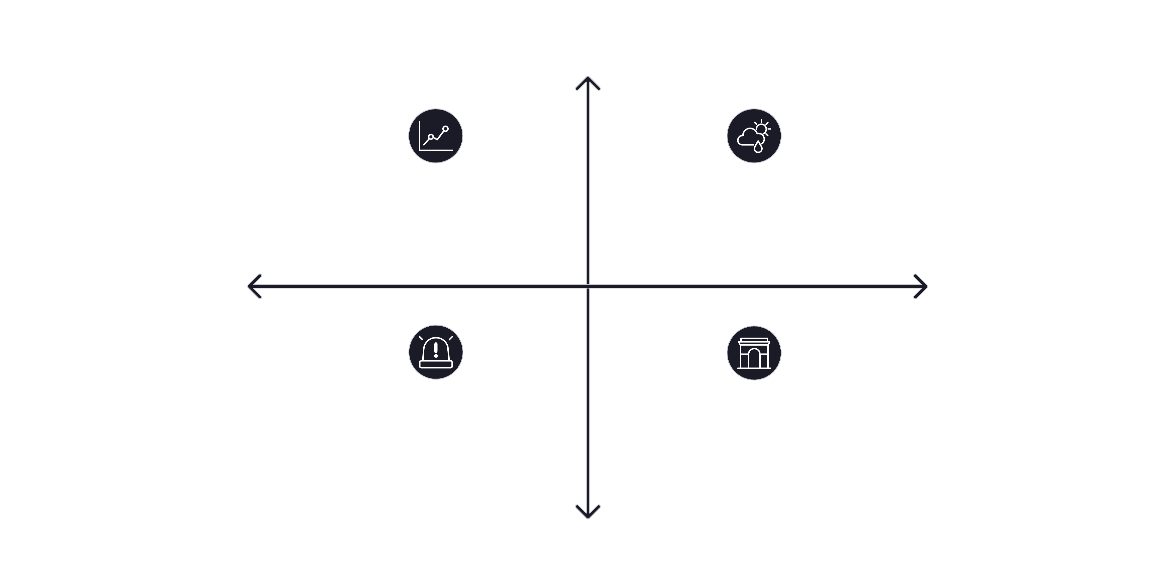




Advanced Analytics: Visualizing Market Opportunities
The dedicated Analytics Page is the heart of Laddr's value proposition, providing complex data visualizations and predictive models via Recharts and interactive maps.
High Predictive Value
Historical Price Trends
ROI Forecasts
Low Economic Influence
High Economic Influence
Risk Factors
Amenities Impact
Low Predictive Value
These visualizations transform raw data into clear, actionable insights, helping users understand market dynamics and predict future performance based on comprehensive modeling.

Slide 6
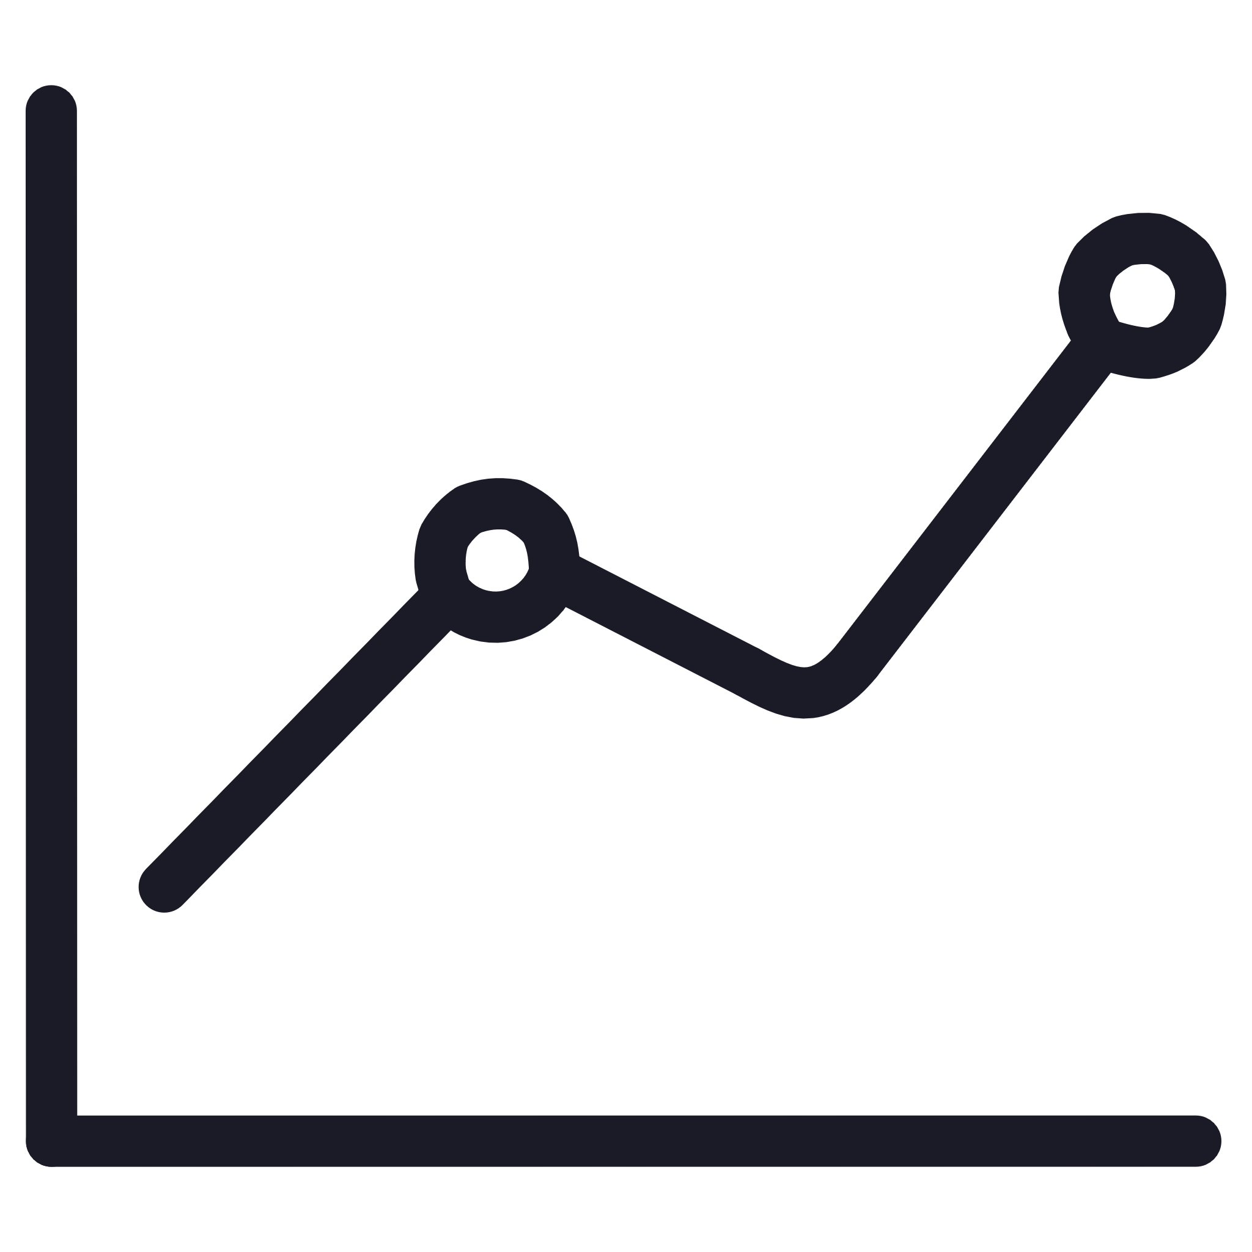



Deep Dive into Investment Metrics and Analysis
Laddr provides granular analysis tools, allowing investors to stress-test their assumptions and identify optimal investment opportunities within specific market segments.
Historical Trends
ROI and Yield
Analysis of price trends over 5, 10, and 20 years to establish long-term market volatility and growth rates.
Detailed ROI forecasts and rental yield analysis to calculate potential passive income and capital appreciation.
Investment Hotspots
Risk and Sentiment
Interactive maps highlighting areas with the highest projected returns and growth potential, aiding geographical strategy.
Assessment of market risk factors and sentiment indicators to quantify potential downsides.
Furthermore, specific analyses include possession status breakdowns and amenity impact on pricing, offering a holistic view of property value drivers.

Slide 7
Backend Architecture and API Endpoints
The backend leverages a robust RESTful API architecture built on Node.js and Express.js, providing the necessary services for data retrieval, analytics computation, and user management.
Database and Data Flow
Key API Routes
The MongoDB database holds key collections like Properties (with embedded price history), Users, and Inquiries.
/api/analytics/*: Handles all complex data summaries, forecasts, and trend analysis.
The data flow is structured: Frontend (Axios) -> Backend (Express) -> Database (MongoDB). Aggregation pipelines are used extensively in MongoDB for complex analytics queries (e.g., average amenity prices).
/api/inquiries: Manages user contact form submissions.
Property CRUD operations (Create, Read, Update, Delete) are also supported.
A crucial element is the use of scripts like populatePriceHistory.js for seeding and maintaining accurate historical data necessary for trend analysis.

Slide 8


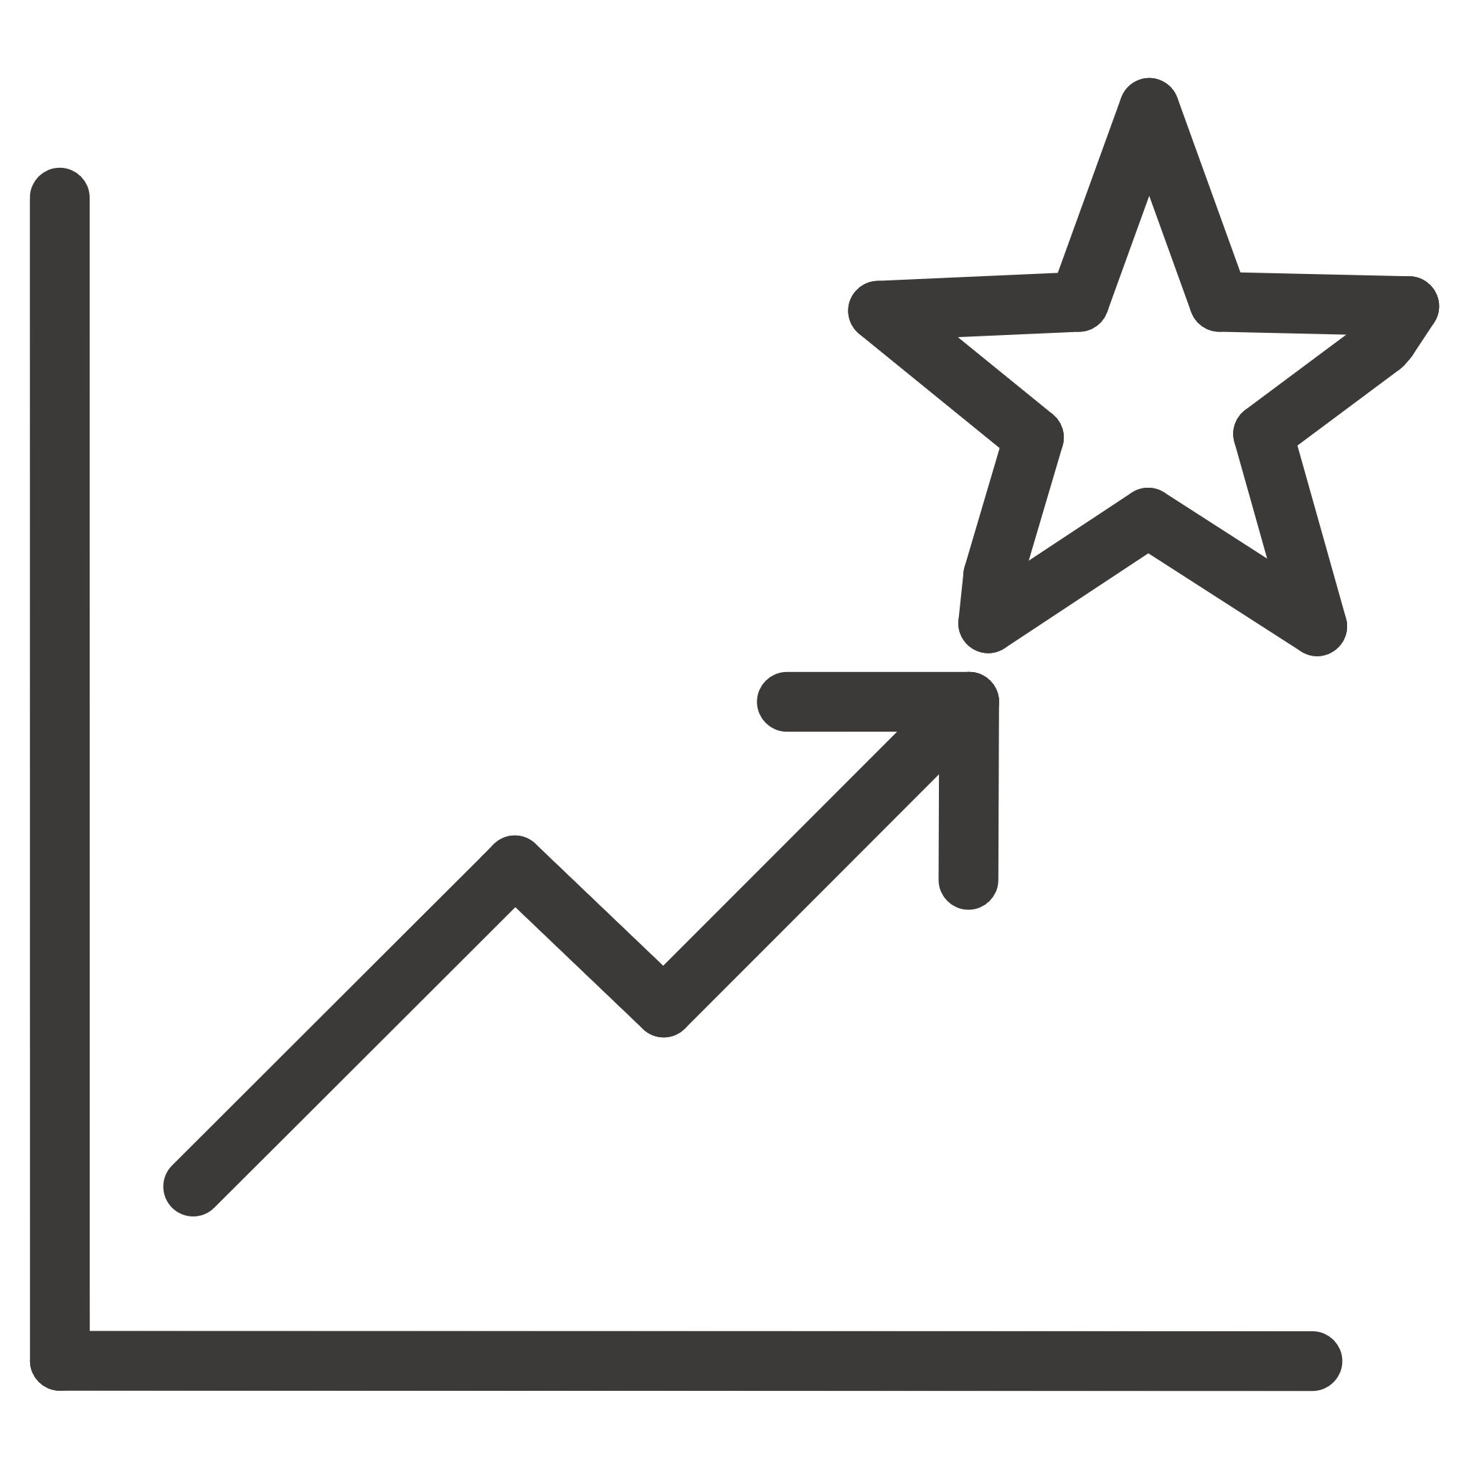

Development & Performance Practices
Adherence to best practices in development, testing, and performance monitoring ensures Laddr remains fast, reliable, and easy to maintain.
Testing
Linting
Unit testing is implemented using Jest and React Testing Library to ensure component reliability and functional correctness across the stack.
ESLint is used for static code analysis, enforcing consistent code quality and identifying potential issues early in the development cycle.
Performance Monitoring
Deployment & Build
Integration with Web Vitals allows for continuous monitoring of user-centric performance metrics, ensuring a smooth and responsive application.
Build process uses Create React App for optimized production bundles (npm run build). Local development utilizes a proxy setup for seamless frontend/backend communication.

Slide 9

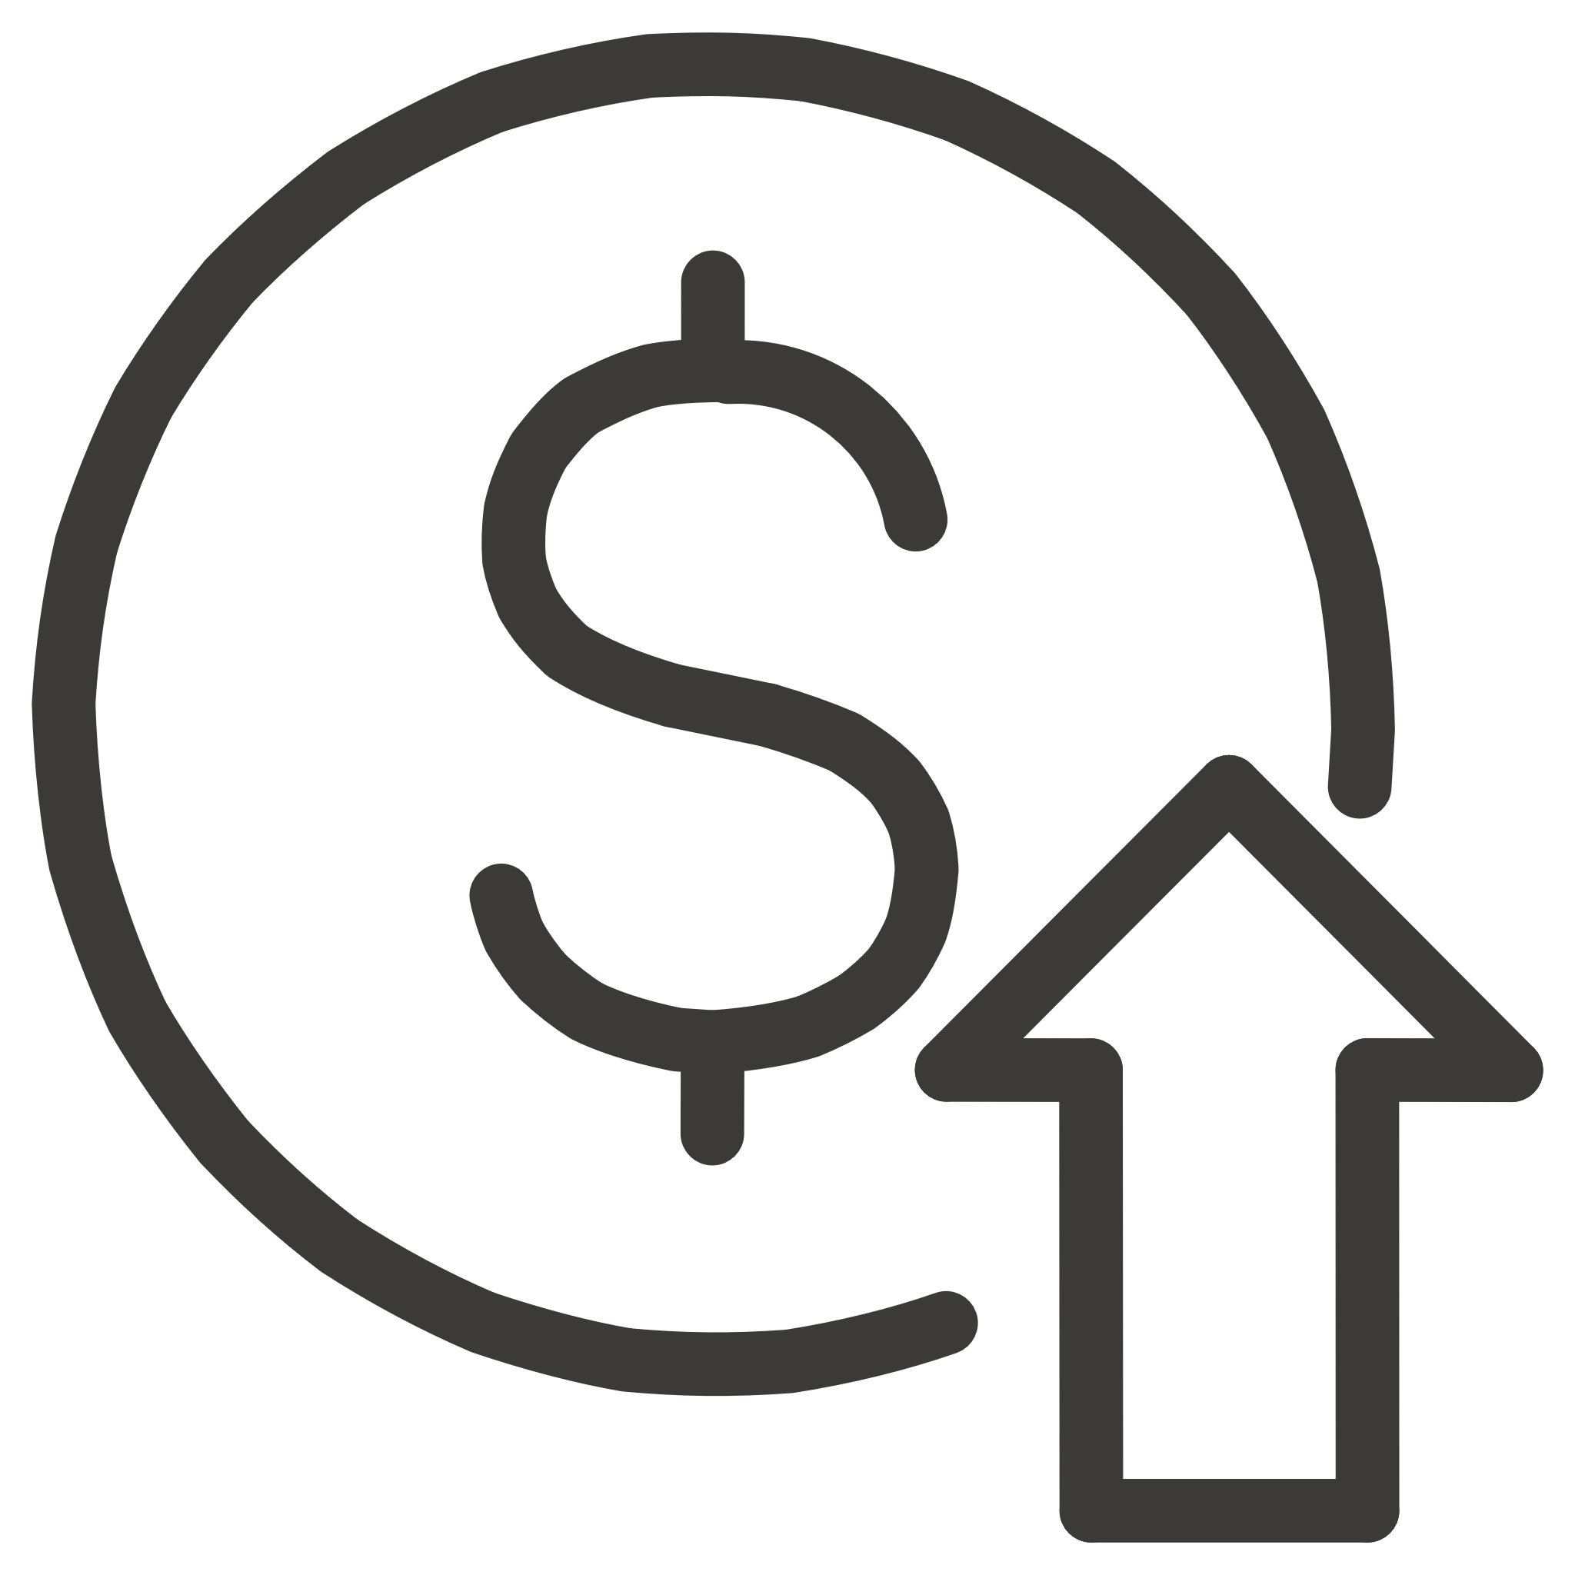

Future Roadmap: Scaling Intelligence and Customization
Laddr is designed for scalability, and our roadmap includes advanced features that leverage machine learning and expanded data integration to further enhance investor edge.
AI Recommendations
AI-powered personalized investment recommendations based on user risk profiles and market trends.
Market Indices
Introduction of Affordability and Liquidity Indices for broader market context.
Advanced Predictions
ML-driven price prediction models and real-time data integration from diverse external sources.
These enhancements will position Laddr as a leader in data-driven real estate investment technology.

Slide 10

Laddr: Your Strategic Advantage in Real Estate Investment
Transforming complex property data into confident, actionable investment decisions.
Laddr provides the technical foundation and feature depth necessary for any modern investor. Its robust architecture and user-centric design ensure it is ready to handle both current market demands and future innovation in the FinTech space.

